Slide 1
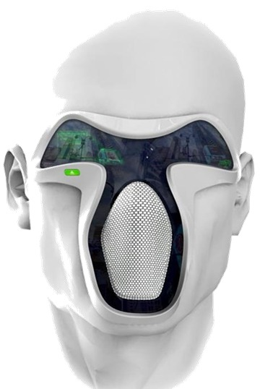

Augmented Reality &
Its Future
Seminar by
Miss Neha A. Rathi
Guided by
Prof. C. S. Dhamande
Department of Computer Science and Engineering
Jawaharlal Darda Institute of Engineering & Technology , Yavatmal

Slide 2
Contents
INTRODUCTION
LITRATURE REVIEW
INVERSE AUGMENTED REALITY : THE FUTURE OF AR
INVERSE AUGMENTED RALITY (IAR)
FRAMEWORK OF INVERSE AUGMENTED REALITY
MATHEMATICAL MODEL
PHYSICAL PERSEPECTIVE OF IAR
REQUIREMENTS
PROOF OF CONCEPT
CHALLENGES FOR AR
CHALLENGES FOR IAR
AR & IAR : THE LIMITLESS POSSIBILITIES
CONCLUSION
REFERENCES

Slide 3
INTRODUCTION
Augmented Reality (AR) is exactly what its name suggests it is when a different reality is over-layered onto your pre-existing reality using certain devices such as smartphones and smart-glasses.
Combines real and virtual objects in real environment
Uses real time view
Alters perspective of reality
Registers (aligns) real and virtual objects with one another

Slide 4
Literature review
1960
1990
2001
2012
2016
3D Graphics
Augmented
Reality
Archioguide
First AR Application
Pokemon Go

Slide 5



Inverse Augmented reality : The future of AR
Inverse Augmented Reality
AI Virtual
Agents
AR, VR & MR

Slide 6
Inverse Augmented reality (IAR)
As artificial intelligence develops rapidly, a virtual agent will finally possess an independent mind similar to that of humans.
A virtual agent can have equal status with real humans.
But the basic frameworks for augmented reality (AR), mixed reality (MR) and virtual reality (VR) are designed for the human-centered world.
The well-known augmented reality can transfer from a human centered framework to a virtual agent-centered framework.
When the virtual agent is the center of the system, it can observe both virtual objects in the virtual world and real objects in the physical world , called IAR.
This is called inverse augmented reality (IAR), because it uses an exactly opposite observing direction compared to the traditional augmented reality

Slide 7
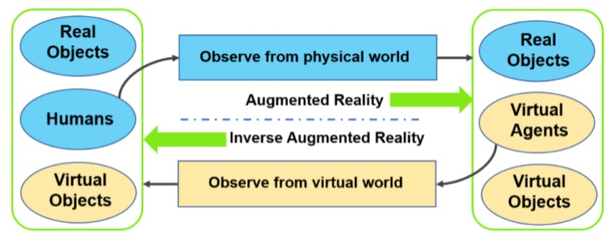
FRAMEWORK OF INVERSE AUGMENTED REALITY
Relationship between AR and IAR
In the right rounded rectangle of the ﬁgure, it shows the typical scene of the traditional augmented reality, which can be observed by humans. In the left rounded rectangle of the ﬁgure, it shows the typical scene of the inverse augmented reality, which can be observed by virtual agents. Augmented reality and inverse augmented reality share the same structure except that they have opposite observing directions and different observers.

Slide 8
Mathematical Model
Take the visual AR and IAR as an example, the formulation for AR and IAR can be as follows.
Let O_{R} denote the real objects, O_{H} the virtual objects, H the humans, A the virtual agents, then we get equation as,
AR ⇔ S_{H}(O_{R} , O_{v} , A)
IAR ⇔ S_{A}(O_{H} , O_{v} , H)
where S_{H} denotes the observation function of humans, and S_{A} denotes the observation function of virtual agents.

Slide 9
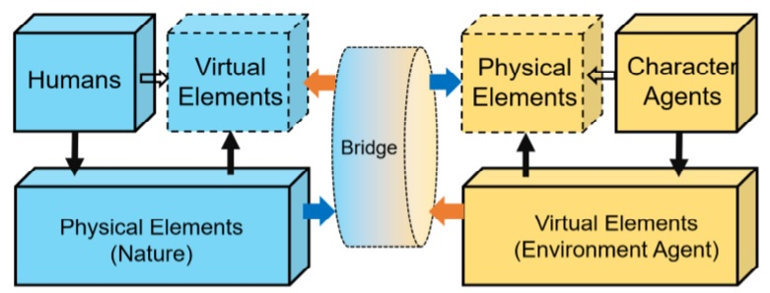
PHYSICAL PERSPECTIVE OF IAR
Interaction between physical world and virtual world.
In this work, emphasize is on the equivalence of the virtual world and the physical world regarding the structure in physics.
IAR has the same important role as the traditional AR. It uses a deﬁnition called physical equivalence to elaborate the equivalence of the physical world and the virtual world.
This means the two worlds should be the same when talking about the physical structure, which can also be seen in above equation.

Slide 10
Spatial
Structure
Self
Development
Equal Status Interaction
Traditional AR
Humans
Physical World
Virtual Contents added to the physical world
Character agent = Virtual
Human in virtual world
The physical world and the virtual world are equal to each other regarding the interaction.
Agents should learn from physical world
And evolve by themselves
The interaction from virtual world to physical world means the virtual agent can control some physical power in order to change the physical state of real objects
Inverse AR
Virtual Characters
Physical Contents added to the virtual world
Programmable Virtual world

Slide 11

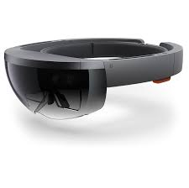

Requirements

Slide 12
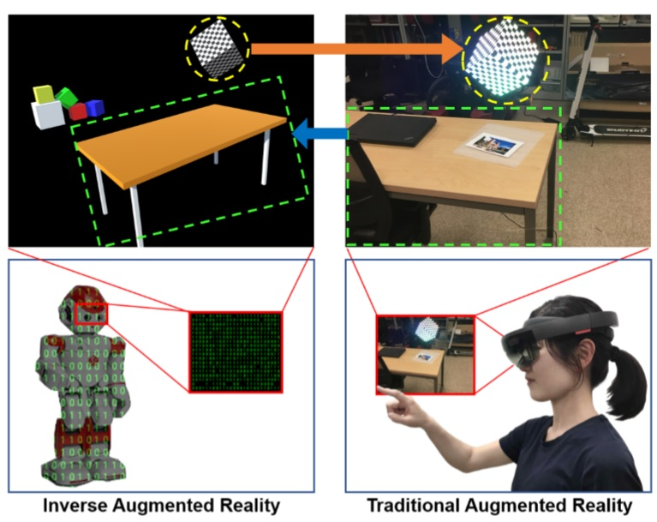
proof of concept
The left side is the view from the virtual world, while the right side is the view from the physical world. Some objects exist in both worlds, such as the cube with yellow dashed circle and the table with green dashed rectangle. Some objects only exist in one world. For example, some colorful cubes only exist in the virtual world, while a chair and a laptop only exist in the physical world.
Concept demonstration

Slide 13
CHALLENGES for AR
Lack of Augmented Reality App Design & Development Standards
Security & Privacy Issues with Augmented Reality
The Possibility of Physical Harm
Social Issues of Augmented Reality: Public Acceptance & Retention
Technological gap between AR devices

Slide 14
CHALLENGES for IAR
Physical construction of virtual objects in the physical world.
Speciﬁc design of virtual-to-physical bridges
Intelligence and knowledge for the self-driven virtual world

Slide 15
AR & IAR : THE LIMITLESS POSSIBILITIES
Education
Surgeries
Entertainment
Gaming
Travelling
Business

Slide 16
CONCLUSION
In this seminar, big framework of the traditional augmented reality and the inverse augmented reality is proposed. Then it illustrate the main properties of this framework. Under this framework, we emphasize that the self intelligence would play an important role in the virtual world, which contributes greatly to building an inverse augmented reality system. It also present a typical implementation of an inverse augmented reality system, which shows the inverse augmented reality can be realized with most current techniques.

Slide 17
REFERENCES
[1] 2018 IEEE International Symposium on Mixed and Augmented Reality Adjunct (ISMAR-Adjunct) Inverse Augmented Reality: A Virtual Agent’s Perspective Zhenliang Zhang, Dongdong Weng*, Haiyan Jiang, Yue Liu, Yongtian Wang
[2] T. Taylor. Evolution in virtual worlds. arXiv preprint arXiv:1710.06055, 2017.
[3] Z. Zhang, B. Cao, J. Guo, D. Weng, Y. Liu, and Y. Wang. Inverse virtual reality: intelligence-driven mutually mirrored world. In Proceedings of IEEE Conference on Virtual Reality and 3D User Interfaces (VR). IEEE, 2018.
[4] Ronald Azuma, Yohan Baillot, Reinhold Behringer, Steven Feiner, Simon julier, Blair MacIntyre “Recent Advances in Augmented Reality”, Computers & Graphics, November 2001K. Elissa, “Title of paper if known,” unpublished.
[5] https://theappsolutions.com/blog/development/augmented-reality-challenges/
[6] https://www.digit.in/technology-guides/fasttrack-to-augmented-reality/ar-the-limitlesspossibilities.html
[7] https://innovatar.io/types-augmented-reality/
[8] https://www.vox.com/platform/amp/2016/2/1/11587458/the-augmented-realityenterprise-opportunity
[9]D.W.F. van Krevelen and R. Poelman “A Survey of Augmented Reality Technologies, Applications and Limitations” The International Journal of Virtual Reality, 2010, 9(2):120M. Young, The Technical Writer’s Handbook. Mill Valley, CA: University Science, 1989.
[10] Nivedha.S1, Hemalatha.S2 “A Survey on Augmented Reality”, International Research Journal of Engineering and Technology, 2015

Slide 18
Thank You !

